Slide 1
Applied Data Science Capstone.
TRAVEL HANDBOOK
By: Rahul Trehan

Slide 2
TABLE OF CONTENTS
INTRODUCTION | 3
DATA | 4
METHODOLOGY | 5
ANALYSIS | 7
RESULTS | 9
DISCUSSION | 11
CONCLUSION | 12

Slide 3
Applied Data Science Capstone. INTRODUCTION
back
Background
Tourism is one of the biggest industries in the world with an approximate size of USD 10 trillion. With better means of travel, communication and ease of connectivity, the industry grew at an approximate CAGR of 3% between 2006 and 2017 as per the World Travel and Tourism Council (WTTC).
There exist many online portals, websites, blogs etc. that cater to the needs of travel enthusiasts in helping them plan their vacations. Also, travel companies advise their clients basis their choices and preferences.
However, it is hard to find blogs that classify cities on an overall basis based on traits that can well explain the cities in terms of its most commonly visited venues & lifestyle.
This became the inspiration for carrying out this analysis as described in the “Business Problem” section.
Problem Statement
In this project, we will investigate the Top 50 most beautiful cities in the world and would try to cluster them into mutually exclusive groups. Similar cities would be clustered basis the category of venues within a specified radius of the city.
We would represent the results in the form of a table and call it “TRAVEL HANDBOOK”.
For reference, the list of cities can be accessed here : https://www.flightnetwork.com/blog/worlds-most-beautiful-cities/
Business Utility
This analysis would be of use to travel enthusiasts and/ or travel magazines/ online portals which frequently publish the list of most beautiful cities that one must visit at least once in a lifetime.
The added advantage here is that, one would be able to group cities into buckets and can make travel itineraries accordingly as per one's choice.
Moreover, this analysis can be carried out at a regular interval to have the latest set of cluster groups.

Slide 4
Applied Data Science Capstone. DATA
back
I have taken the list of "THE WORLD'S 50 MOST BEAUTIFUL CITIES” from the website https://www.flightnetwork.com/blog/worlds-most-beautiful-cities/
The website contains a numbered list of the top 50 cities globally. As such, BeautifulSoup package has been used to scrape the website and get the top 50 cities in a tabular format.
In order to find out the geographical coordinates of these cities, the geopy package was used.
Next, Foursquare was used to explore the vicinity of these top 50 cities.
A radius of 20 km from the city center was chosen and limit of 1000 results per city was applied.

Slide 5
Applied Data Science Capstone. METHODOLOGY
back
Step 1: Web Scraping to get the list of cities
Step 2: Getting geographical coordinates
Step 3: Obtaining the vicinity data from Foursquare.
Step 4: Employing KMeans clustering technique to cluster the cities basis the data obtained from Foursquare. We will choose the best number of clusters by iterating through a range of cluster numbers (Elbow Method of best k determination). This is as shown below:

Slide 6
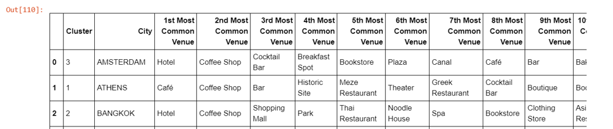
Applied Data Science Capstone. METHODOLOGY (Contd.)
back
Step 5: Clustering data with k=6 and then clusters are plotted on the map
Step 6: Obtaining the top 10 most common venues for every city as shown below:
Step 7: Next, for each cluster we will find the top 3 most visited venues for the cluster. In case of a tie, we will go for the next top venue in the cluster.

Slide 7
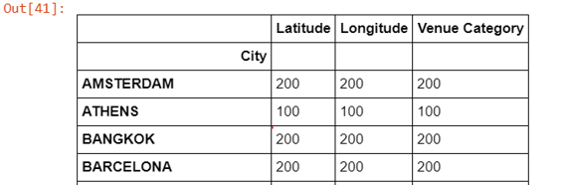
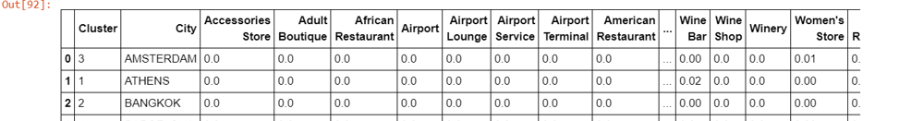
Applied Data Science Capstone. analysis
back
Although, the nature of data does not warrant much of Exploratory Data Analysis, the analysis phase primarily involves step by step implementation to draw conclusions from the raw data
1. Checking the number of venues obtained per city. Maximum number of venues for any city is 200.
2. Creating dummy variables using one-hot encoding on the Venue Category column. We notice there are 390 unique venue categories.
3. Getting mean score per city across all venue categories.
4. Performing K Means Clustering on the location data.

Slide 8
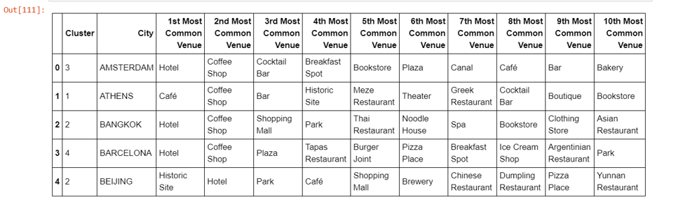
Applied Data Science Capstone. analysis
back
5. Obtaining the top 10 most common venues for each city

Slide 9
Applied Data Science Capstone. results
back
Cluster | Cities |  |  | # of Cities | Top 3 Venues (Count in the Cluster) | Cluster Label
0 | Berlin Chicago Dublin Edinburgh Toronto | London New York Prague Quebec-city Vancouver | Rio-de-Janerio San-Diego San-Francisco Sydney | 14 | Park (14) Coffee-shop (12) Ice cream shop (10) | PARKS
1 | Athens San-Sebastian | Bergen Zurich | Bruges | 5 | Bar (5) Hotel (4) Bakery (3) | BARS
2 | Bangkok Beijing Cartagena Cusco Singapore | Dubai Dubrovnik Havana Hong Kong | Jerusalem Queenstown San-Miguel-de-Allende Jaipur | 13 | Hotel (13) Cafe (8) Restaurant (8) | HOTELS
3 | Amsterdam Budapest Cape-Town | Istanbul Quito Seoul | St-Petersburg Tokyo Hanoi | 9 | Coffee Shop (9) Hotel (9) Park (6) | COFFEE SHOPS
4 | Barcelona Buenos-Aires Lisbon | Madrid Paris Rome | Venice Vienna | 8 | Plaza (8) Ice Cream Shop (7) Park (6) | PLAZAS
5 | Marrakesh |  |  | 1 | Bed & Breakfast | BED & BREAKFAST

Slide 10
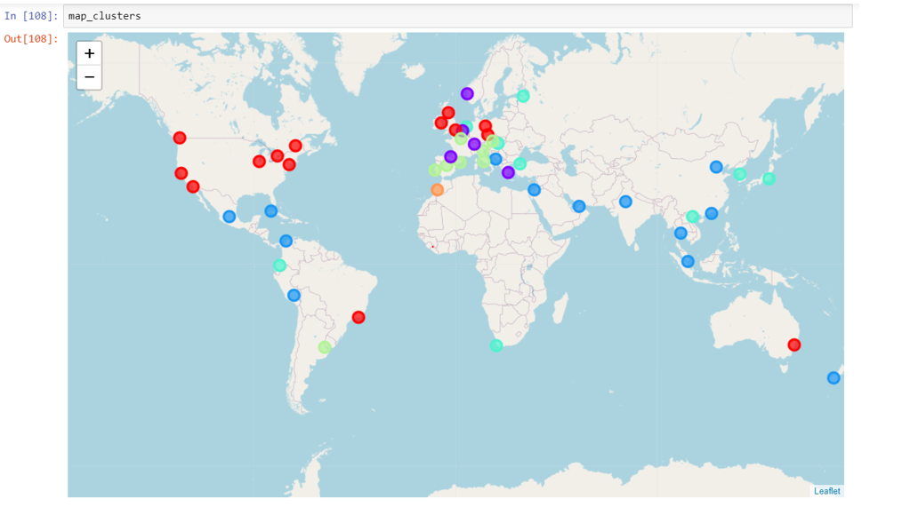
Applied Data Science Capstone. results
back

Slide 11
Applied Data Science Capstone. discussions
back
We have obtained six major cluster of cities characterized by Parks, Bars, Hotels, Coffee Shops, Plazas and Bed & Breakfast. All clusters barring Bed & Breakfast have multiple cities in them.
The city of Marrakesh seems to be quite interesting as it did not share similarities with the remaining 49 cities. Something to really check out!!
Also, for cluster 3, Coffee Shops and Hotels share the same count, i.e. 3. We have however chosen Coffee Shops for the following reasons:
Coffee Shops does not qualify as label for any other cluster
Hotels has already been assigned to cluster 2

Slide 12
Applied Data Science Capstone. conclusion
back
Purpose of this project was to identify similar cities among top 50 most beautiful cities globally in terms of venues in their vicinity. This was primarily done in order to understand the cities better in terms of their lifestyle and choices. The objective behind this project was to help travel enthusiasts in planning and make intelligent decisions while travelling/ recommending travel itineraries. This is equally useful for online portals/ travel magazines.
Note: While it is fully understandable that each city may have a different most common venue, we will try to label the clusters basis the top 3 venues for each cluster and for its underlying cities.
Also, cluster label/ Speciality_Hangouts, thus obtained after the analysis, clearly imply that the specialty will be present in at least one of the top 10 most visited place in any city of that particular cluster.
While this analysis tries to present a holistic view of the top 50 cities, final decision to consider one's travel plans will be strictly one's own decision and this may depend on several other factors and preferences.

